Slide 1






Grafikos Website
Enhancement

Slide 2

01.Current Website Overview
Existing functionalities
02. Gap Analysis
03. Final Analysis
04. Proposed Enhancements
New features with its benefits
05. Project Flow
Agenda

Slide 3
Current Website Overview
Existing Functionalities
Pages & Sections
Home Page
About Page
Services Page
Contains 4 Sections
Section 1 - Hero section
Section 2 - List of services offered
Section 3 - Completed Projects
Section 4 - Contact Details
Contains 4 Sections
Section 1 - Company
Section 2 - Process
Section 3 - Mission and Vision
Section 4 - Team Grafikos
Contains 1 Section
Section 1 - List of Services
Project Page
Contains 2 Sections
Section 1 - Completed projects
Section 2 - Satisfied Clients testimonials
Contains 1 section
Section 1 - Has contact address with social media links and email.
Contact Page

Slide 4
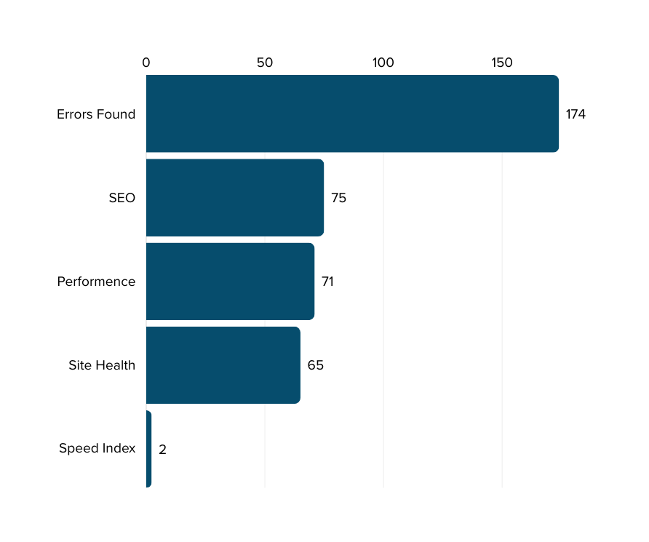
Gap Analysis
Current Performance
Issues
Title Tag Contains 130 Characters but Should be below 60.
Text-to-HTML Ratio is 8.34% but Should Be around 15% to 20%.
Missing XML Sitemap.
47 Broken Links found.
High Loading Time.
Missing 404 Error Page.

Slide 5
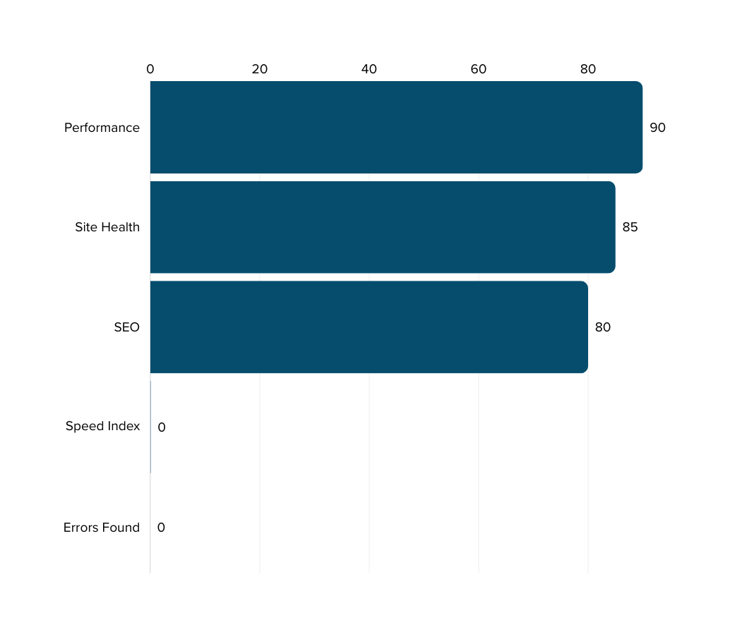
Final Analysis
SEO Score:
Aim for an SEO score above 80 out of 100.
Performance:
Target a performance score above 90 out of 100 for both mobile and desktop.
Errors Found:
Aim for zero critical errors (like server errors) and minimal broken links.
Site Health:
Ensure your website is secure with HTTPS and scores well on security headers (A or A+).
Speed Index:
Target a Speed Index score of under 3 seconds.

Slide 6



Proposed Enhancements
New Features with Benefits
Blog Page
Career Page
Client Voices
Benefits
Benefits
Benefits
Improved SEO
Regular updates with industry news and insights
Enhanced User Engagement
Social handle back links
Hiring good talents
Easy application
Providing Internship opportunities
Builds trust
Encourages trust in your services.
Builds a positive company image.

Slide 7


Proposed Enhancements
New Features with Benefits
Chat Integration
Contact Form
Benefits
Benefits
Instant messaging feature for
immediate assistance.
Chatbot for quick answers to common questions.
Collecting required information from the clients.
Makes website more professional.

Slide 8





Project Flow
Phase 1: Project Initiation and Planning
Documenting project requirements and obtaining layout approval from stakeholders.
Phase 2: Data Collection and Integration
Gathering necessary data and inputs from clients to integrate into the project framework.
Phase 3: Project Preview and Review
Presenting a preliminary preview of the project to clients for feedback and validation.
Phase 4: Client Feedback and Iteration
Collecting and incorporating client reviews to refine and enhance the project as per their requirements.
Phase 5: Comprehensive Testing and Quality Assurance
Conducting thorough testing and validation across all aspects of the project to ensure functionality, performance, and user satisfaction.

